Slide 1

ICT 581 HTML5 and CSS3 with jQuery
Continuing Education
Day 7: Lists and Keys, Forms, Lifting State Up
Mostafa Mohamed, PhD, P.Eng.
Adjunct Professor,
Electrical and Software Engineering Department
Mostafa.Mohamed@ucalgary.ca
@ 2022

Slide 2
Previous Class
React State and Lifecycle
Events
Conditional Rendering

Slide 3
Agenda
Lists and Keys
Forms
Lifting State Up
Reading:
https://reactjs.org/docs/lists-and-keys.html
https://reactjs.org/docs/forms.html
https://reactjs.org/docs/lifting-state-up.html

Slide 4
JS Array Mapping
JS arrays have many functions including map()
map() generates a new array by applying a function on each element of the given array
const numbers = [4, 9, 16, 25];
const doubles = numbers.map((number) => number * 2)
Read more here:
https://www.w3schools.com/jsref/jsref_map.asp
See day7-demo0-array-map.html

Slide 5
Lists and Keys

Slide 6
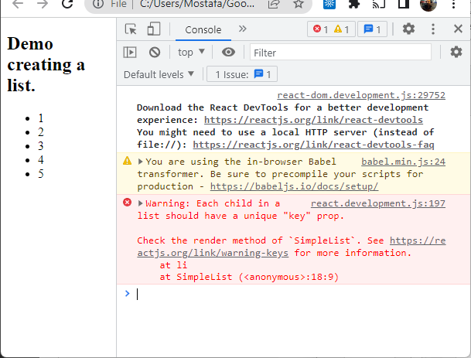
Using Array Map()
We can use Map() method to generate multiple UI elements in out JSX code
const numbers = [1, 2, 3, 4, 5];
const listItems = numbers.map(
(number) => <li>{number}</li> );
This will create a list, but will give you a warning
You need to add a key to each element in your list for React to monitor the changes in each element
See day7-demo1-lists.html

Slide 7
List with Keys
Add a key for each element in your list
You can use any generate key such as the index given by the Map() method (not recommended)
Always supply a Key with any code generated by map()
Each child node should have a unique key
const listItems = numbers.map((number, index) =>
<li key={index}>{number}<sup>2</sup> = {number ** 2}</li>
);
See day7-demo2-listskeys.html

Slide 8
Key as IDs
The key should be unique and relevant to the data such as a record ID
const students = [{ id: 11, name: 'Sam' }, { id: 13, name: 'Ali' }, { id: 25, name: 'Mike' }];
const listItems = students.map((student, index) =>
<li key={student.id}>{student.id}: {student.name}</li>
);
See: day7-demo3-listskeys-ids.html

Slide 9
React Forms

Slide 10
Controlled Components
HTML form inputs manage their own states (input values)
In React, we want to manage all states in our React code
We develop what is called “Controlled Components”
In Controlled Components, we take handle the user inputs, and show it in the UI by setting a state variable
See day7-demo4-forms.html

Slide 11
Select input
Uses value as the selected value
<form onSubmit={this.handleSubmit}>
<label>Choose your country:
<select value={this.state.value} onChange={this.handleChange}>
<option value="ca">Canada</option>
<option value="us">USA</option>
<option value="eg">Egypt</option>
</select>
</label>
<input type="submit" value="Submit" />
</form>

Slide 12
Lifting State Up

Slide 13
Common States
All common states that need to be shared between components should be stored in a common parent.
Parent
States
Child 2
Child 1

Slide 14
Activity

Slide 15
Create a Weather Page
Use weather API to show weather forecasting.

Slide 17
Summary
Lists and Keys
Forms
Lifting State Up

Slide 18
Thank you for attending today!!!
Mostafa Mohamed, PhD, P.Eng.
Mostafa.Mohamed@ucalgary.ca
WhatsApp: 403-966-8112

